Slide 1

Native Mobile Applications Development
Presented by:
Ahmed Mazen

Slide 2



Important Connections
MAD44-Alex
mad44-alex@googlegroups.com
MAD44Alex@gmail.com

Slide 3
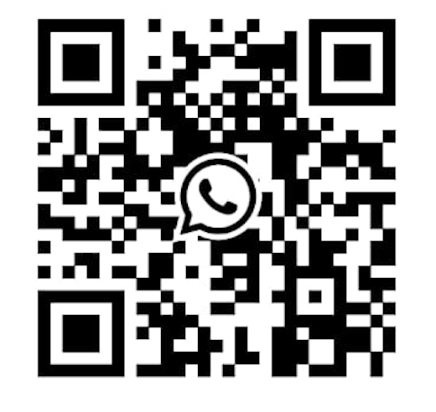
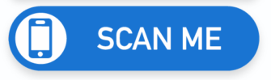
Permissions Request:
Track Supervisor:
Eng. Hager Samir
Mobile:
010 226 65 636
Time:
07:00 A.M. – 08:00 P.M.
NO Permissions via WhatsApp
NO Permissions via SMS

Slide 4
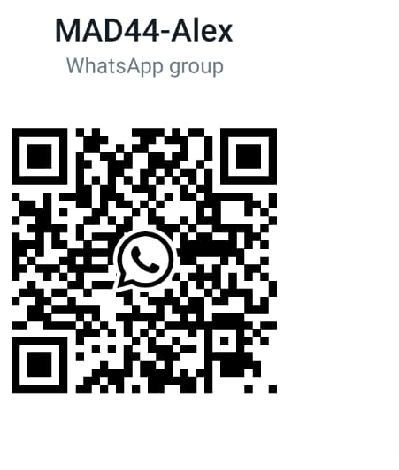
Join

Slide 5
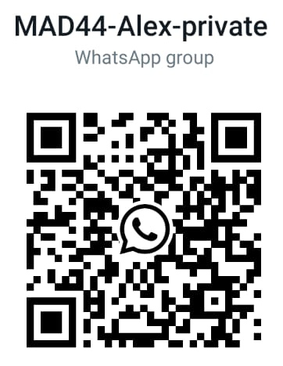
Join

Slide 6
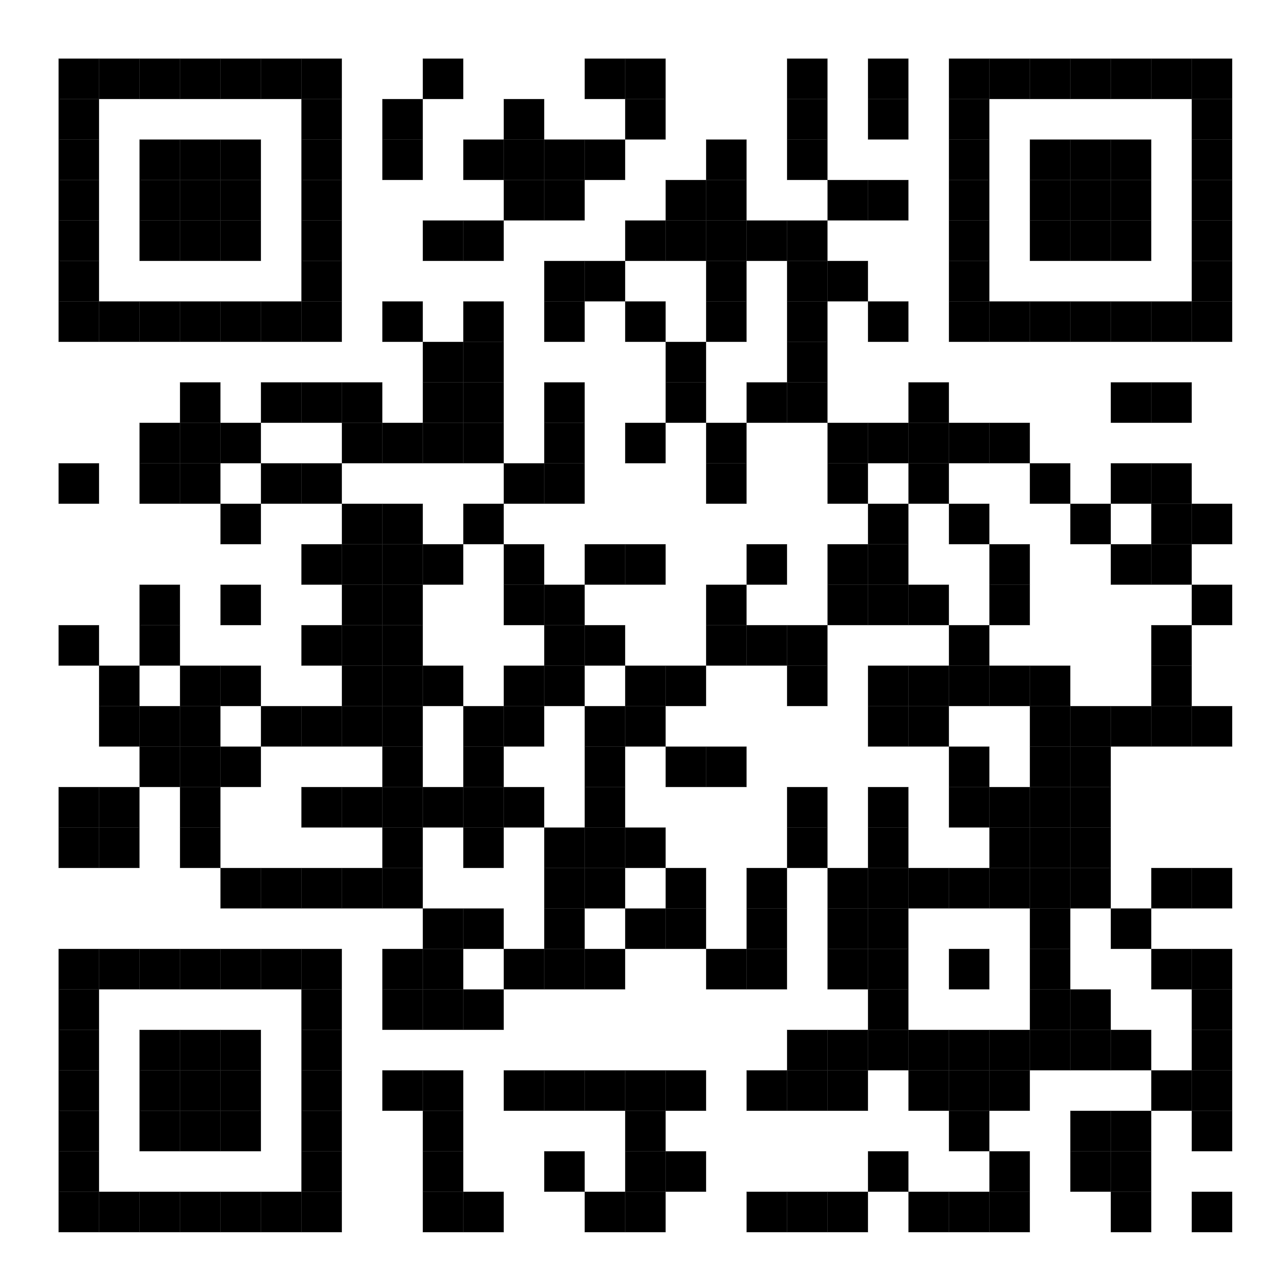
Register Your Data

